Slide 1
Strategy and Management Control system

Slide 2
Tasks Involved in Strategic Management & MCS
Defining business and stating a mission
Setting measurable objectives
Crafting a strategy to achieve objectives
Implementing a strategy
Evaluating performance of the strategy, reviewing new developments and taking corrective action

Slide 3
The essence of strategy of the organization
Perspective strategy or rational view
An emergent view

Slide 4
Rational perspective

Slide 5
Developing a Mission & Objectives
An organization’s Mission
Reflects management’s purpose of operating the business
Provides a clear view of what the organization is trying to accomplish for its customers
Indicates intent to take a business position
An organization’s Objectives
Convert the mission into performance targets
Track performance over time
Must be achievable
Two types
Financial – outcomes that relate to improving financial performance
Strategic – outcomes that will result in greater competitiveness & stronger long-term market position

Slide 6
BBC’s purpose statement
“To educate, inform and entertain”
Walt Disney’s Purpose Statement
“To make people happy”

Slide 7
Management accounting and strategy
• Objectives
- Specific statement of what the organisation aims to
achieve, often quantified and relating to a specific period of time (SMART)
• Strategies
-
Strategy is the direction and scope of an organisation over the long term which achieves advantage for the organisation through its configuration of resources within a changing environment to fulfil stakeholder expectations.
G. Johnson and K. Scholes Exploring Corporate Strategy 6th edition

Slide 8
The essence of strategic management-a perspective view
• Major decisions
- What business will we operate in?
- What are our basic directions for the future
- What systems and structures should we have in place
to support our strategies?
• Corporate strategy
- Decisions about the types of businesses to operate in, which businesses to acquire and divest, and how best to structure and finance the organisation

Slide 9
If DSI confines itself footwear business, can they offer tyres , tubes, schoolbags?

Slide 10
What business are you in?
If you want to travel from London to Manchester, you can choose from the train, coach, car or
aeroplane, so what business should Ryanair be in?

Slide 11
Levels of Strategy
Corporate strategy
Business strategy
Functional strategy

Slide 12
Corporate Level Strategy
What businesses are we in? What businesses should we be in?
Four areas of focus
Diversification management (acquisitions and divestitures)
Synergy between units
Investment priorities
Business level strategy approval (but not crafting)

Slide 13
Corporate-Level Strategies
Valuable
strengths
Concentric/Related Diversification
Corporate
growth
strategies
(Economies of Scope)
Conglomerate/Unrelated
Diversification
(Risk Mgt.)
Corporate
stability
strategies
Firm
Status
Corporate
retrenchment
strategies
Critical
weaknesses
Turn around/Divestment/Liquidation
environmental
opportunities
Critical
environmental
threats
Environmental Status

Slide 14
The BCG “Portfolio” Matrix
Market Share
High
Low
Stars
Question Marks
?
?
?
High
?
Anticipated
Growth
Rate
Cash Cows
Dogs
Low

Slide 15
Portfolio decision
 | A | B | C | Total
Revenue | 1 m | 2m | 3m | 6.00
-Variable cost | 0.2 | 0.5 | 1.5m | (2.20)
Contribution | 0.8 | 1.5m | 1.5m | 3.80m
-Fixed cost | 0.9 | 0.9 | 0.9 | 2.7m
Profit | (0.1) | 0.6 | 0.6 | 1.1m
Product A in the portfolio has been making continues losses during last few financial years of the company. Advice whether the product A should be discontinued or not.

Slide 16
Business Level Strategy
How do we support the corporate strategy?
How do we compete in a specific business arena?
Three types of business level strategies:
Low cost producer
Differentiator
Focus
Four areas of focus
Generate sustainable competitive advantages
Develop and nurture (potentially) valuable capabilities
Respond to environmental changes
Approval of functional level strategies

Slide 17
Functional / Operational Level Strategy
Functional: How do we support the business level strategy?
Operational: How do we support the functional level strategy?
An example.
Business L.S.: Become the low cost producer of widgets
Functional L.S. (Mfg.): Reduce manufacturing costs by 10%
Operational (Plant #1): Increase worker productivity by 15%

Slide 18
A Simple Organization Chart (Single Product Business)
Business
Level
Strategy
Business
Research and
Development
Human
Resources
Manufacturing
Marketing
Finance
Functional
Level
Strategy

Slide 19
A Simple Organization Chart (Dominant or Related Product Business)
Corporate
Level
Multi
business
Corporation
Business
Level
Business 1
(Related)
Business 2
(Related)
Business 3
(Related)
Functional
Level
Research and
Development
Human
Resources
Manufacturing
Marketing
Finance

Slide 20
An example of an Unrelated Product Business (Note: By itself, an SBU can be considered a related product business)
SBU: a single business or collection of related businesses that is independent and formulates its own strategy
A
(Multi-business) Corporation
Ex.: G.E. (General
Electric Corp.)
Strategic Business Unit 1
S.B.U.
2
Company 1
Co. 2
Co. 3
Division 1
Div. 2
Div. 3

Slide 21
What business are you in?

Slide 22
An emergent view
Emphasize the uncertainty of the future and suggest that setting out identify purpose and a single strategy and then develop a complete strategic plan may be fruitless task

Slide 23
What is emergent perspective to strategy
A set of certain consistent actions that form an unintended pattern that was not initially anticipated or intended in the initial planning phase. For example, although unintended, adopting an emergent strategy might help a business adapt more flexibly to the practicalities of changing market conditions.
Strategy
More planned approached/ Intended strategy
Emerged outside the formal plan /Unintended pattern recognizing the changing conditions

Slide 24
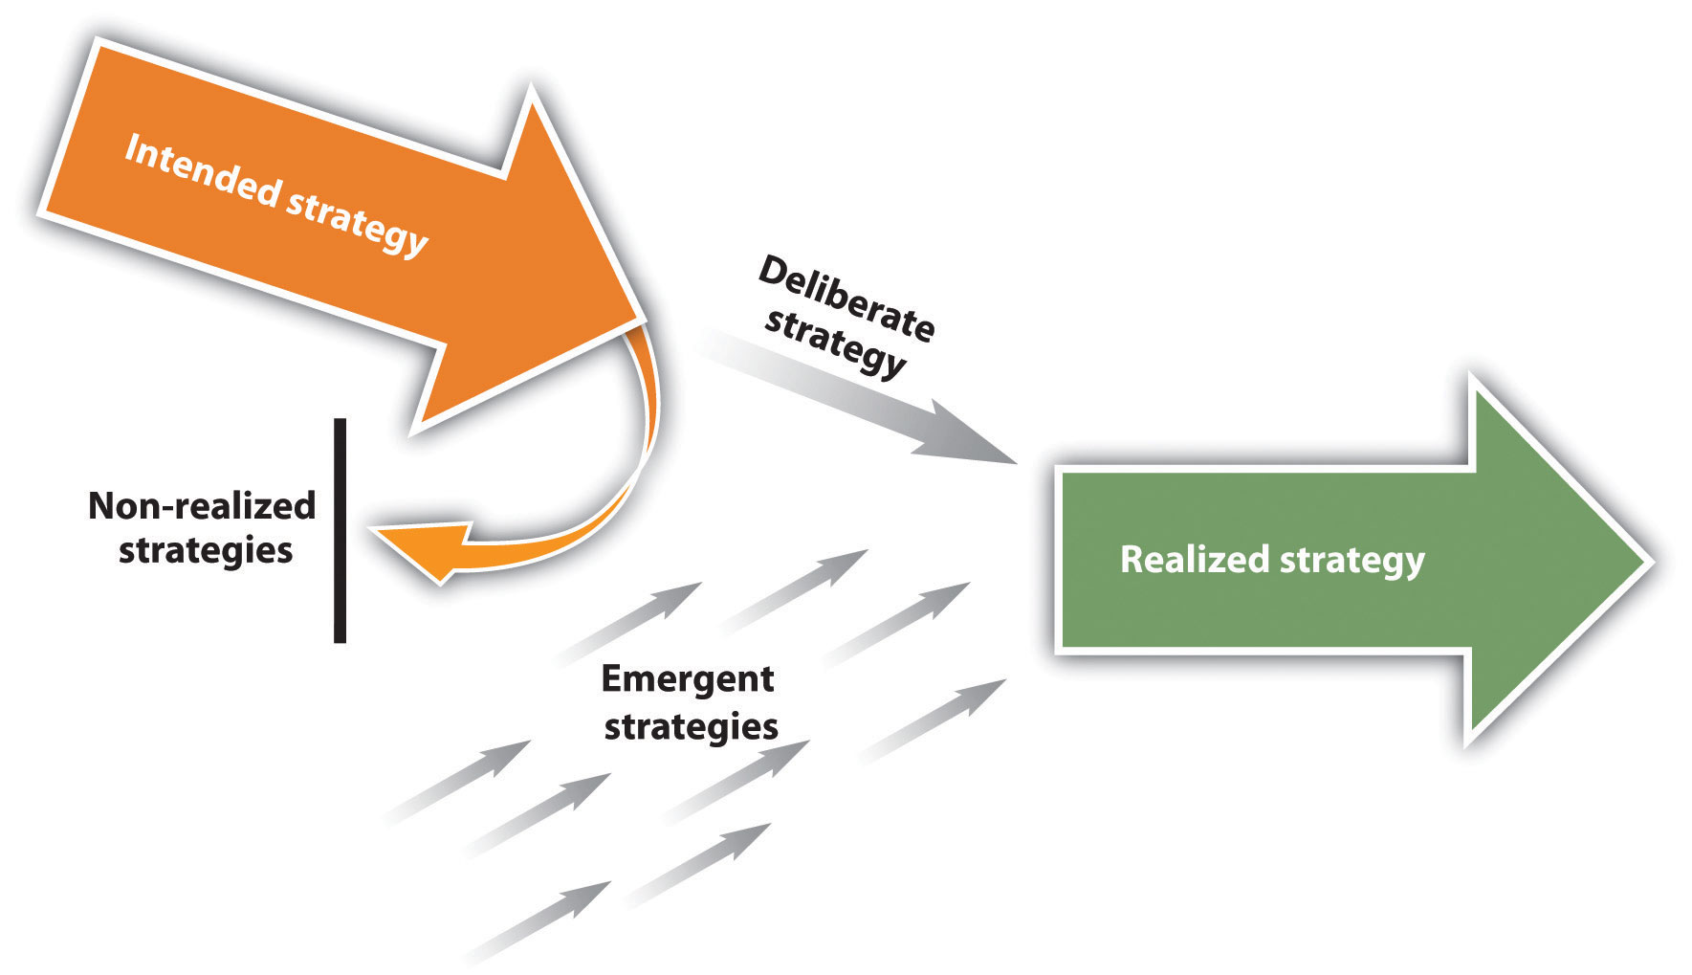
Henry Mintzberg's emergent strategy

Slide 25
Strategic drift
Strategic happens when organization strategy is no longer relevant to the external environment facing it
Environment forces
?????
Intended strategy through Deliberate planning process
Strategic drift

Slide 26
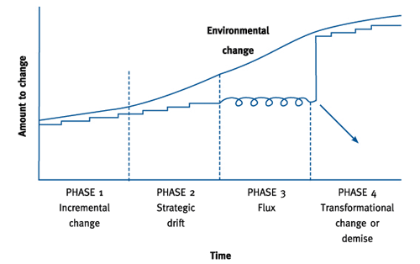
Rate of responding to the environmental change

Slide 27
What if you don’t redefine your business purpose –Strategic drift

Slide 28
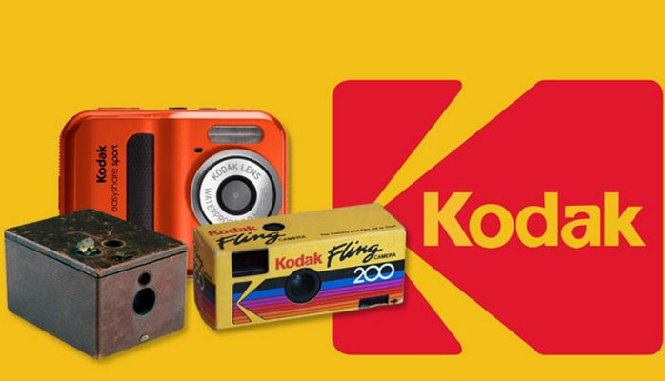
Slow response to the market led to strategic drift

Slide 29
How can companies survive a strategic drift
Organizational leadership and adaptable culture
Continues assessment of trends, emergence of direct and indirect competitors, technological changes and adjustment in to the current plan. https://www.youtube.com/watch?v=dqwAZKrc6vw

